Slide 1

Numpy, Pandas, Visualization - Part 1
Basics of Numpy

Slide 2
Introduction

Slide 3
Introduction to NumPy?
NumPy stands for ‘Numeric Python’
Used for mathematical and scientific computations
Also provides ‘linalg’ module which contains functions like det, eig, norm to apply linear algebra on NumPy arrays
NumPy array is the most widely used object of the NumPy library

Slide 4
Introduction to NumPy?
Installing NumPy
Use the following command to install Numpy using jupyter notebook
Importing numpy as alias np is a common practice

Slide 5
NumPy array

Slide 6
Numpy array
Looks similar to a list
It is a grid of values, indexed by positive integers
It generally contains numeric values. However it can also contain strings
Works faster than lists
It can be multidimensional

Slide 7
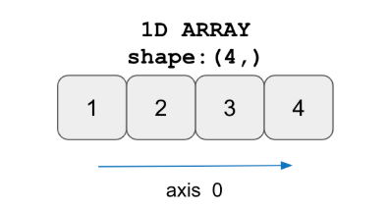
1D NumPy array
One dimensional array contains elements only in one dimension. In other words, the shape of the numpy array should contain only one value in the tuple

Slide 8
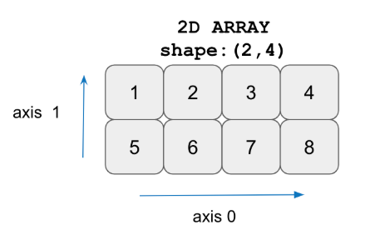
2D NumPy array
Two dimensional array is an array within an array
The position of an data element is referred by two indices instead of one

Slide 9
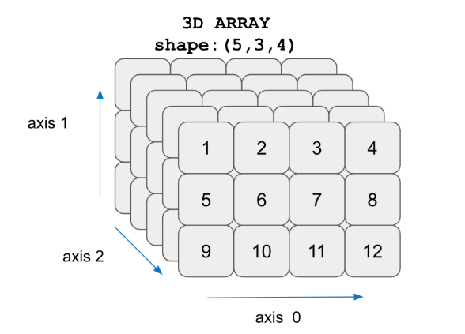
3D NumPy array
A three-dimensional (3D) array is composed of 3 nested levels of arrays, one for each dimension

Slide 10
Creating NumPy Array

Slide 11
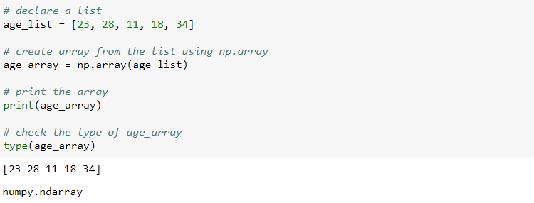
Converting a list into NumPy array
np.array() is used to create a numpy array from a list

Slide 12
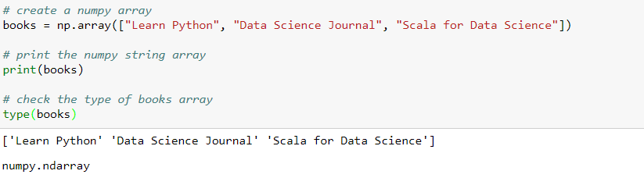
Creating numpy array
Numpy arrays be used to create array of strings as well

Slide 13
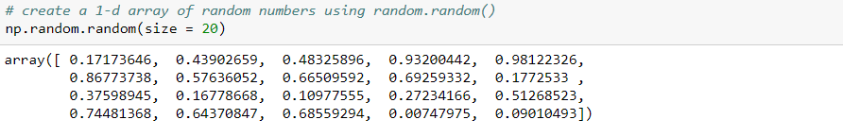
Numpy array of random numbers
Create an array of 20 random numbers using random() method from the random module
random() method returns random numbers over the half-open interval [0.0, 1.0)
The required number of random numbers is passed through the ‘size’ parameter

Slide 14

Numpy array of random numbers
rand() method creates an array of random numbers of the given shape and between (0, 1)
The dimensions of the returned array, should all be positive
If no argument is given a single Python float is returned

Slide 15

Numpy array of random numbers
The randn() returns a set of values from -1 to +1 (excluding -1 and +1)
The dimensions of the returned array, should all be positive
If no argument is given a single Python float is returned

Slide 16
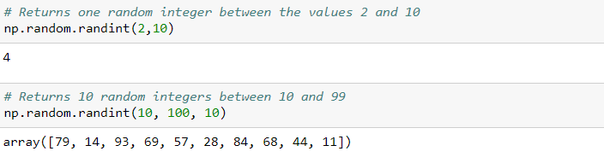
Numpy array of random numbers
The randint() returns random integers from low (inclusive) to high (exclusive)

Slide 17
Creating numpy array using arange()
np.arange() can also be used to create a NumPy array
The numbers generated have the same difference
The function generates as many possible numbers in the given range
The function name
The data type (optional)
Numpy.arange (start, stop, step, dtype)
The start of the interval (optional). Default is 0
The “step” between values (optional)
The end of the interval

Slide 18
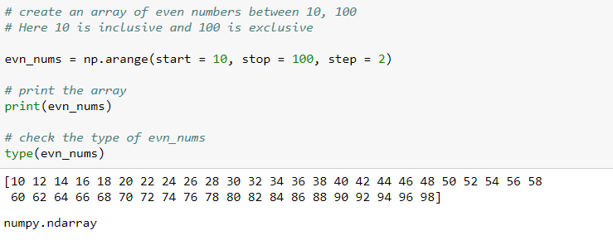
Creating numpy array using arange()
The np.arange() create a series of values from 10 to 100 with a difference of 2, stored as a numpy array

Slide 19
Creating numpy array using linspace()
linspace() generates a specified number of values in a specified range
Syntax:
The start of the interval (optional)
The number of values required in the interval
numpy.linspace ( start, stop , num, dtype )
The data type (optional)
The end of the interval

Slide 20
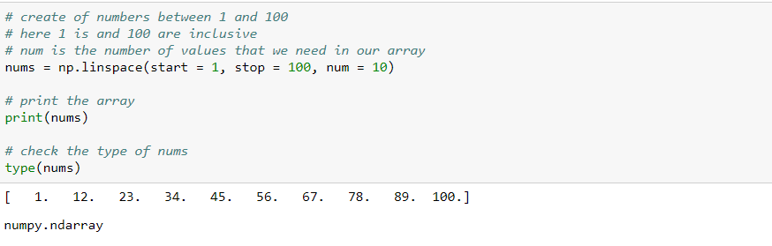
Creating numpy array using linspace()
np.linspace() produces a sequence of 10 evenly spaced values from 1 to 100, stored as a numpy array

Slide 21


Creating numpy array of zeros
Creating 1D numpy array of zeros
Creating 1D numpy array of ones

Slide 22
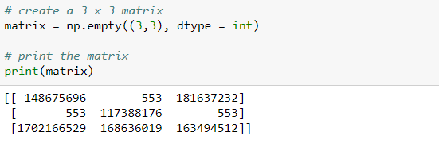
Creating 2d numpy array
np.empty() returns the matrix with arbitrary values of given shape and data type
‘dtype = object’ returns None values

Slide 23
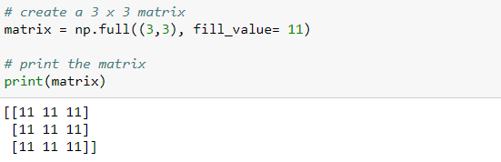
Creating 2d numpy array
np.full() returns the matrix of given shape with the value set by the ‘fill_value’ parameter

Slide 24
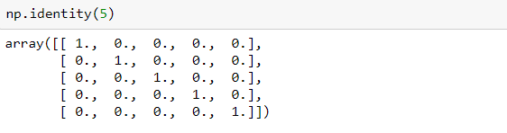
Creating 2d numpy array
np.identity() returns identity the matrix of specified shape

Slide 25
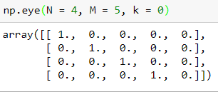
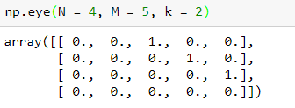
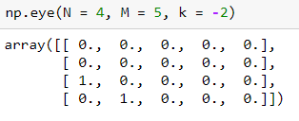
Creating 2d numpy array
np.eye() creates NxM matrix with value ‘1’ on the k-th diagonal and remaining entries as zero
K > 0 represents upper diagonal
K < 0 represents lower diagonal
K = 0 represents main diagonal
K > 0 represents upper diagonal
K < 0 represents lower diagonal

Slide 26
Array Attributes

Slide 27
Array Attributes
Attributes are the features/characteristics of an object that describes the object
Some of the attributes of the numpy array are:
⚬ shape
⚬ size
⚬ dtype
⚬ ndim
Note: Attributes do not have parentheses following them

Slide 28
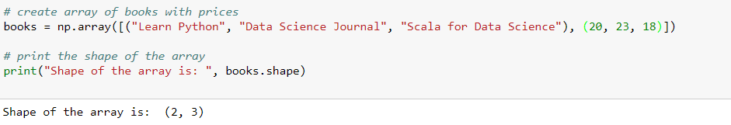
Array Attributes - shape
The shape returns the number of rows and columns of the array respectively

Slide 29
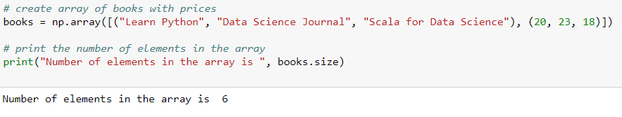
Array Attributes - size
The size returns the number of elements in an array

Slide 30
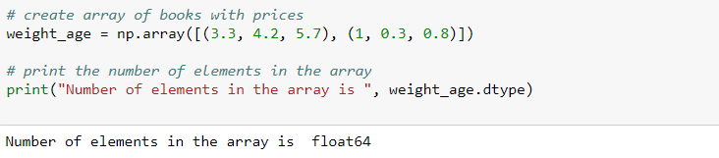
Array Attributes - dtype
The dtype returns the type of the data along with the size in bytes
In the example, the array consists of 64-bit floating-point numbers. Thus, the dtype of the array is float64

Slide 31
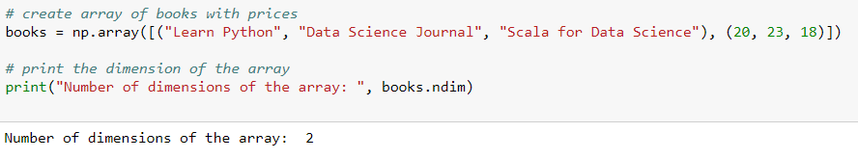
Array Attributes - ndim
The ndim returns the number of axes (dimension) of the array

Slide 32
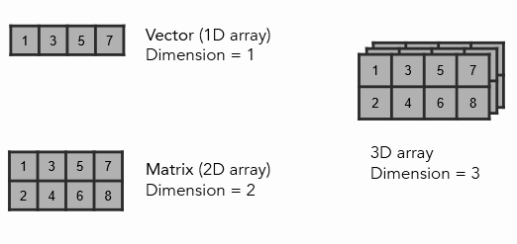
Array Attributes - ndim

Slide 33
Array Methods

Slide 34
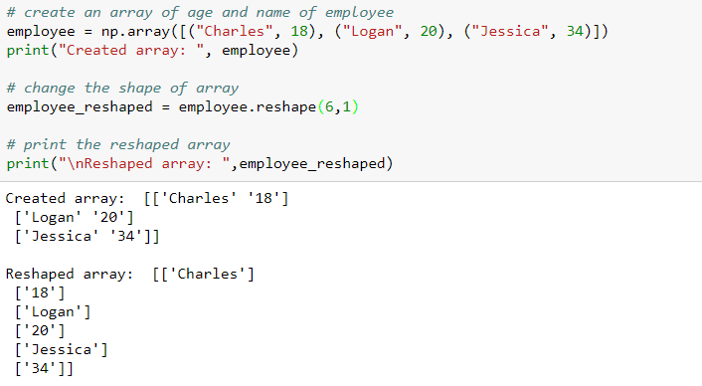
Array Methods
Methods are object functions that takes parameters in the parentheses and returns the modified object

Slide 35
Array Methods
In the example, the reshape(6, 1) is reshaping a 3 X 2 array to 6 X 1 array

Slide 36
THANK YOU
Presenter’s Name
Contact Us
support@knowledgehut.com
Presenter’s Designation

